Slide 1
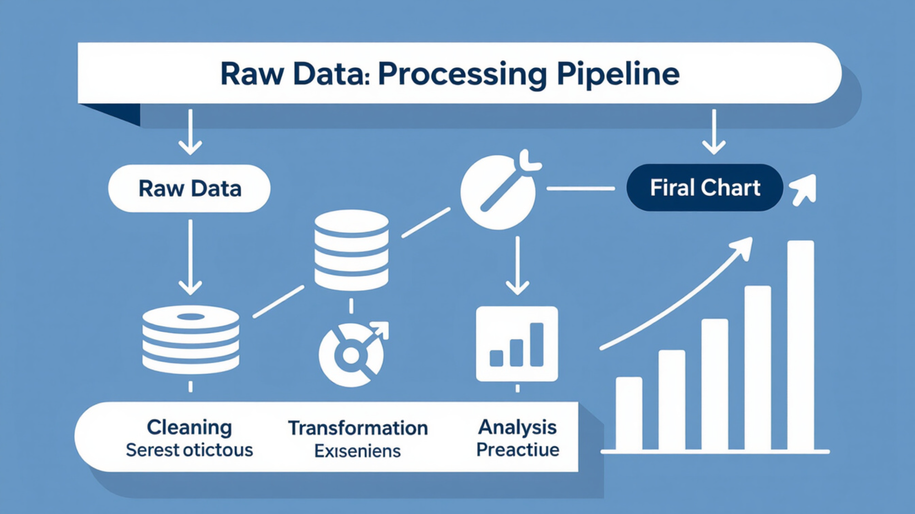

Sample Programs to Pre-process and Visualize Data
THE FOUNDATION OF DATA SCIENCE
Modern computational analysis relies on a robust data pipeline. Before insights can be extracted, data must undergo a rigorous transformation process to ensure accuracy and reliability.
The Data Lifecycle
Core Objective
Academic Context
Raw collection to actionable visualization
Bridging theory and real-world datasets
Automating cleaning and
representation

Slide 2



The Role of Data Preparation
Why Raw Data is Insufficient
Integrity
Poorly prepared data leads to biased models and misleading visualizations.
Raw data is frequently "dirty," containing inconsistencies, errors, and formats that machines cannot directly process. Systematic preparation is the most time-consuming yet critical phase of any analysis project.
Efficiency
Clean data reduces computational overhead and simplifies algorithmic complexity.
Consistency
The "Garbage In, Garbage Out" Principle
Standardizing formats ensures that different software modules can communicate effectively.
The quality of your output is directly limited by the quality of your input.

Slide 3
Common Pre-processing Techniques
Feature Engineering and Transformation
Programs must transform raw variables into a format suitable for mathematical modeling.
Technique | Purpose | Common Method
Scaling | Adjusts data to a specific range | Min-Max Scaling (0 to 1)
Normalization | Centers data around a mean | Z-score Standardization
Encoding | Converts text to numbers | One-Hot Encoding
Binning | Groups continuous values | Histogram Bucketing

Slide 4


Handling Missing and Noisy Data
Addressing Data Gaps
Noise and Outliers
Real-world datasets often have "holes" where information was not recorded.
Outliers can skew results and distort visualizations. Detection methods, such as the Interquartile Range (IQR) or Z-score thresholds, allow programs to identify and either smooth or remove these anomalies.
Deletion:
Removing rows/columns with missing values (best for large datasets).
Imputation:
Filling gaps using statistical measures like the mean, median, or mode.
Advanced Estimation:
Using regression or K-Nearest Neighbors to predict missing values.
Maintain Data Integrity

Slide 5




Principles of Effective Data Visualization
Data visualization is the graphical representation of information. Its goal is to communicate complex patterns clearly and efficiently.
Clarity
Accuracy
Remove "chart junk"—unnecessary gridlines or decorations that distract.
Ensure scales are not misleading (e.g., starting the Y-axis at zero).
Cognitive Load
Integrity
Minimize mental effort using intuitive colors and labels.
The visual must be a faithful reflection of the pre-processed numbers.

Slide 6
Selecting the Right Chart Types
Chart Selection Logic Effectiveness
Matching Structure to Visuals
Scatter Plots: Best for showing the relationship or correlation between two variables.
Histograms: Ideal for visualizing the distribution and frequency.
Bar Charts: The standard for comparing discrete categories.
Heatmaps: Effective for large matrices or correlations across many variables.

Slide 7

Integrating Cleaning and Plotting Workflows
Pre-processing and visualization are not isolated steps; they are iterative.
Raw Data Input
Pre-processing (Cleaning/Scaling)
Data Visualization
Interpretation & Feedback
Impact of Cleaning on Output
If data is not normalized, a heatmap may show false intensity. If outliers are not handled, a scatter plot may become unreadable due to extreme scaling.

